Slide 1
Fluid Methods for Modeling Large, Heterogeneous Networks
W. Gong, J. Kurose, V. Misra,
D. Towsley
U. Massachusetts
http://gaia.cs.umass.edu/fluid/

Slide 2
Overview
project challenges and goals
research strategy
new ideas
progress to date
summary

Slide 3

Fluid Methods for Modeling Large,
Heterogeneous Networks
New Ideas
TCP flow
throughput
Fixed point algorithms to predict performance of large networks supporting TCP flows.
Stochastic differential equations (SDE) to study transient behavior of large networks supporting TCP flows.
Deployment in Fluid Analysis of Networks tool (FAN).
time
avg queue length
RED
router
time
Impact
Schedule
Rapid network configuration. Fluid-based methods will permit rapid solution of many alternate network configurations.
Large network solutions. Methods handle networks with 1000s of elements, 100,000s of TCP-like flows.
Active queue management. Methods will permit systematic study of active mechanisms at routers.
Development of fixed point based algorithms
Development of SDE based algorithms
FAN tool development
Development of active queue management and Diff-Serv mechanisms
Year 1
Year 2
Year 3

Slide 4
Challenge
explore alternate network configurations prior to deployment/reconfiguration
explore alternate active queue management (AQM), congestion control designs
Parameter space:
  100s - 1000s network elements
  10,000s - 100,000s of flows (TCP, UDP, NG)

Slide 5
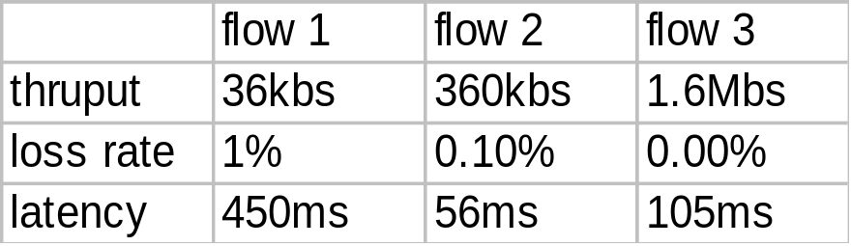
Project Goals/Challenges
Steady state behavior
develop fast algorithms for accurate prediction of steady-state behavior of large, heterogeneous IP networks
develop efficient algorithms for transient analysis of large, heterogeneous IP networks
develop/refine congestion control policies
Transient response
TCP throughput
time

Slide 6
Potential Impact
ability to evaluate performance of large networks in an on-line manner
ability to rapidly evaluate performance of network prior to deployment
ability to evaluate queue management designs for large networks
ability to come up with better congestion management algorithms

Slide 7
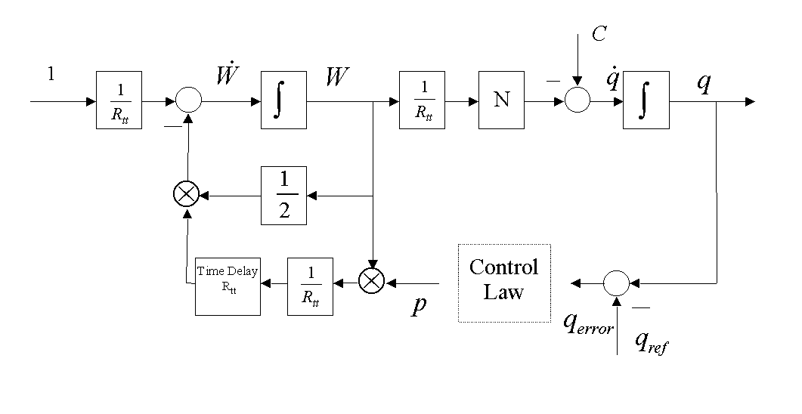
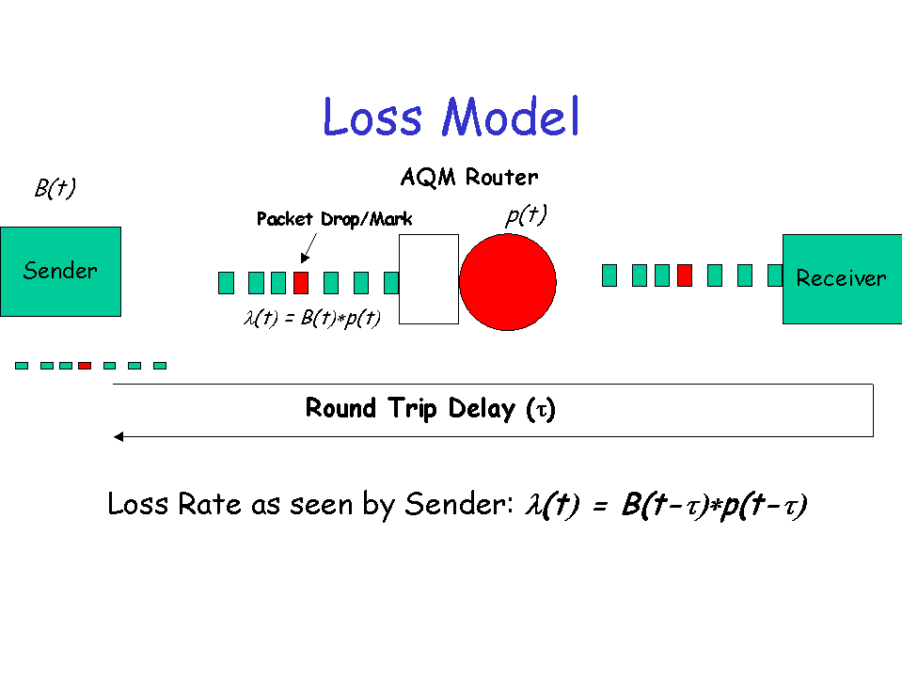
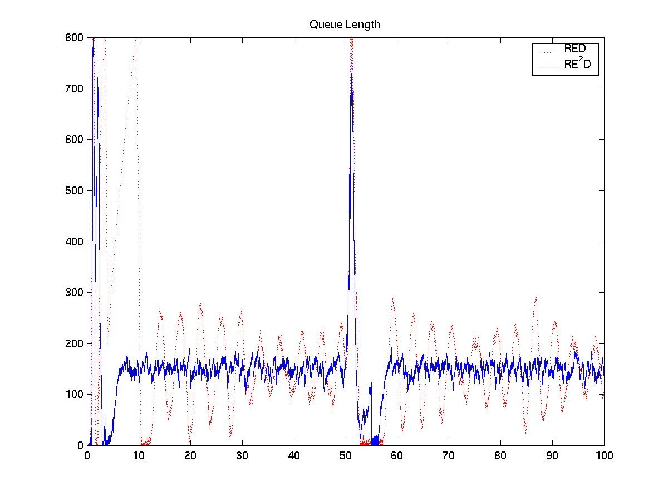
Three pronged research approach
Understanding
Modeling
Application

Slide 8
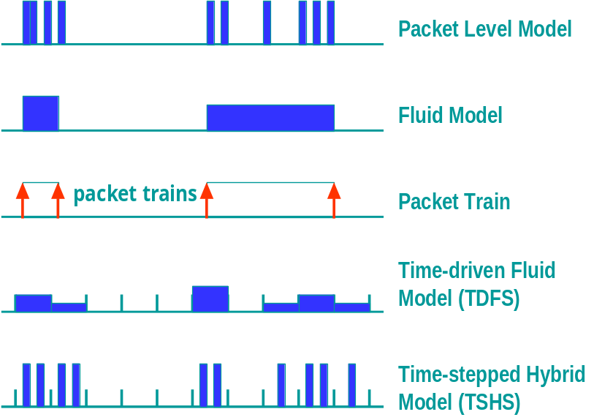
New Ideas
use of fixed point methods for on-line evaluation of steady-state behavior of large networks handling responsive flows (e.g., TCP)
use of fluid models with different granularities and stochastic differential equations to evaluate transient behavior of such networks
TCP throughput
avg. queue length

Slide 9
Fixed Point Approach
N TCP flows
  throughputs {B_{i} }
V bottlenecked RED routers
  capacities {C_{v} }
  avg. queue lengths {x_{v} }
  discard prob. {p_{v} (x_{v} )}
TCP model: B_{i} ({p_{v} })
bottleneck router model
Σ_{i} B_{i} ({x_{v} }) = C_{v} , v =1,…,V
V equations, V unknowns
TCP flow i
RED
router
C_{v}, p_{v}(x_{v})
AQM
router
C, p

Slide 10
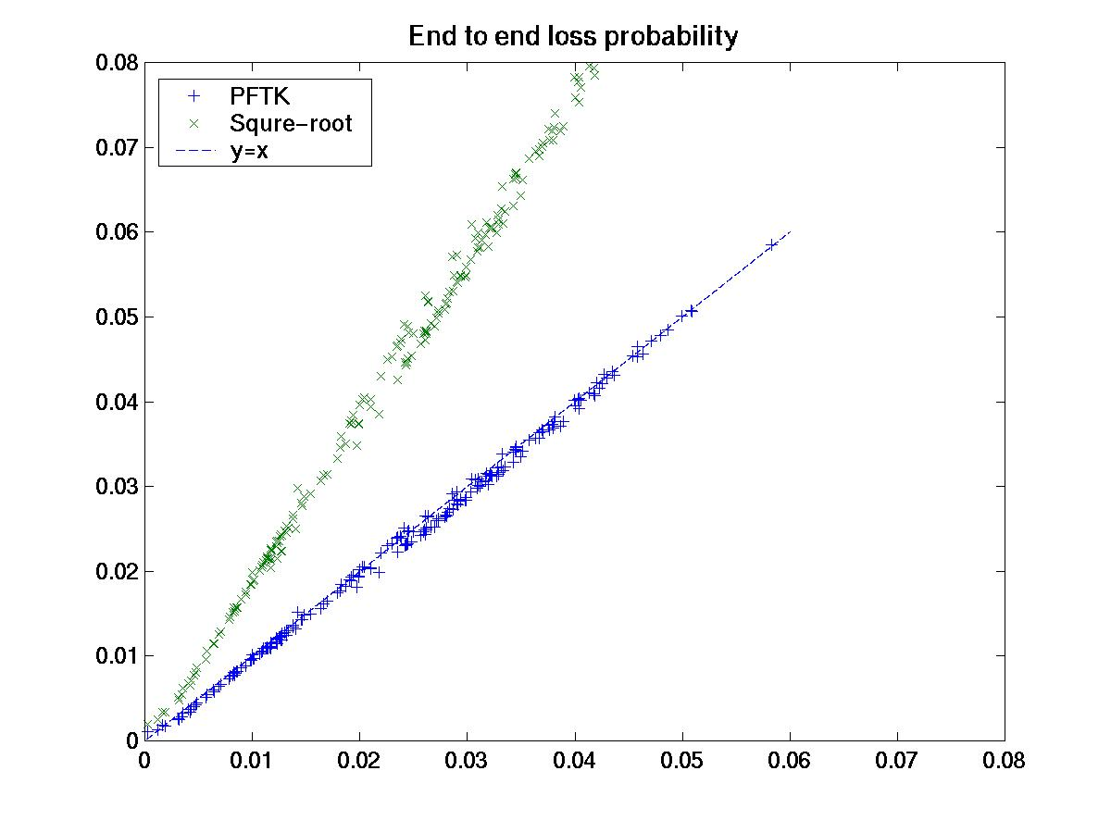
Results: tandem network
8 configurations, [5 ,10] routers each
two way propagation delay [20,120] ms
bandwidth, [2,6] Mbps
error in prediction vs. simulation
  throughput < 10%
  loss rate < 10%
  avg. queue length < 15%
Predicted
Simulated

Slide 11
Future research: fixed point methods (12 month)
validate approach; choice of B()
account for non-responsive flows (e.g., UDP), finite duration flows (e.g., http)
establish existence/uniqueness of solution
adapt for multicast, DiffServ

Slide 12
SDE Methods
model traffic as fluid
describe behavior of flows and queues using Stochastic Differential Equations
obtain Ordinary Differential Equations by taking expectations of SDEs
solve resultant coupled ODEs numerically

Slide 13
Example: DEs for Single Router
W=Window size, R = RTT, q = queue length, p = marking probability
dW_{i}
dt
=
f₁(p,R_{i}) i = 1..N
dq
dt
dp
dt
= f₃(q)
= f₂(W_{i})
N+2 coupled equations to be solved numerically

Slide 14
Validation scenario
Topology
DE system programmed with RED AQM policy
equivalent system simulated in ns
transient queuing performance obtained
one way, ftp flows used as traffic sources
Flow set 4
Flow set 1
RED router 1
RED router 2
Flow set 2
Flow set 3
Flow set 5
5 sets of flows
2 RED routers
Set 2 flows through both routers

Slide 15
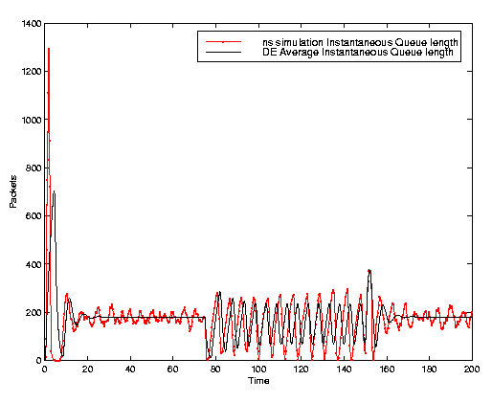
Performance of SDE method
queue capacities 5 Mb/s
load variation at t=75 and t=150 seconds
200 flows simulated
DE solver captures transient performance
time taken for DE solver ~ 5 seconds on P450
Inst. queue length for router 2
DE method
ns simulation
Inst. queue length
Time

Slide 16
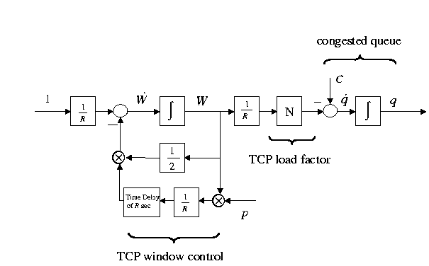
Added benefit: analytical models
differential equation modeling enables casting in classical control systems framework
scientific, theory based parameter tuning

Slide 17
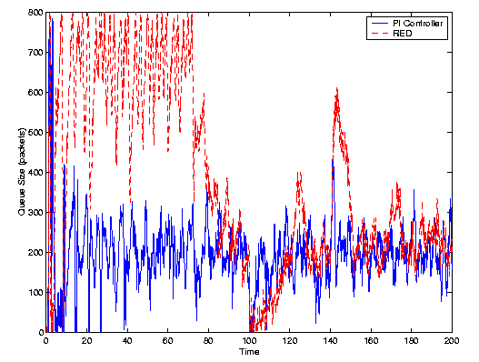
Improving congestion control
Queue length vs. Time
PI controller compared with classical RED controller
ns simulation with time varying http,ftp flows
PI controller: faster response and decouples queue size , load levels
- PI Controller
- RED Controller
queue length
time

Slide 18
Future research: differential equation methods (12 month)
include short lived and non-responsive flows in model
develop an optimized, fast implementation of the DE solver
apply DE model of network system to develop new queue management designs, congestion control algorithms, ...

Slide 19
Synergies
Collaboration with UIUC
Other modeling tie-ups :?
Need:
- Measurements to build better traffic models
Provide:
  Models for simulation teams (?)

Slide 20
Project Summary
develop analytical models to describe behavior of (large) networks
develop fast predictors and simulators for rapid and online evaluation of large networks
leverage understanding to develop better control mechanisms and improve network performance

